Slide 1
Multimedia Projekt
SS 2017
Team 4
Pedestrian Detection
Multimedia Project
SS 2017
Team 4
University Augsburg
Multimedia Projekt - SS17 - Team 4

Slide 2
summary
Evaluation
  Qualitativ evaluation
    Success
    Failures
    Comparison First and retrained SVM
  Quantitativ evaluation (DET)
Specifics of our method
Future Work
Demonstration
Multimedia Projekt - SS17 - Team 4

Slide 3
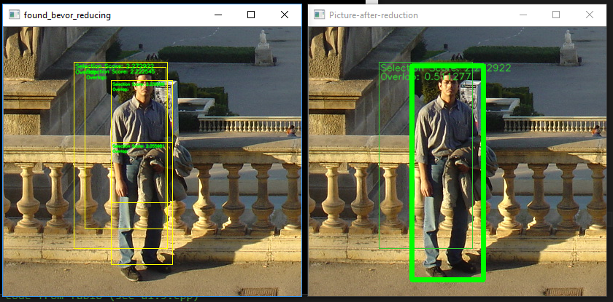
Evaluation - Qualitative
Multimedia Projekt - SS17 - Team 4

Slide 4
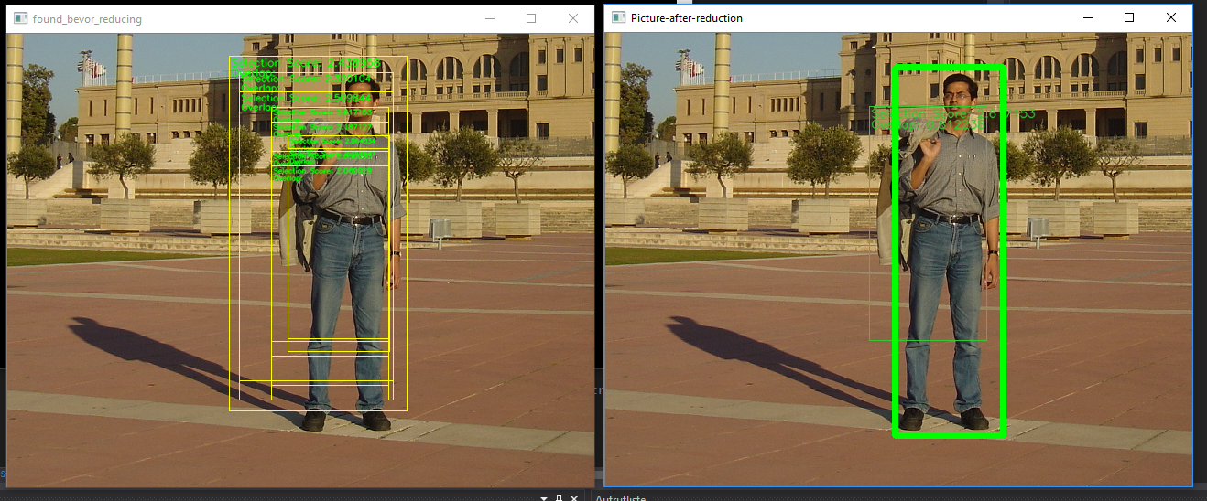
Evaluation - Qualitative
Selection of the best frame? score vs. size
Multimedia Projekt - SS17 - Team 4

Slide 5
Evaluation - Qualitative
Comparison of first and retrain with pictures
Multimedia Projekt - SS17 - Team 4

Slide 6
Evaluation - Qualitative
Failures
Multimedia Projekt - SS17 - Team 4

Slide 7
Evaluation - Quantitativ
DET
Multimedia Projekt - SS17 - Team 4

Slide 8
Characteristics of our method
Mirrored pictures for training
10 templates for each negative training picture
Oversampling for balanced size
Retraining with „worst“ 5000 hard negatives
Multimedia Projekt - SS17 - Team 4

Slide 9
Characteristics of our method
SVM parameter
  100.000 iterations
  C = 0.1
  24550 input samples
  Linear kernel
h
Multimedia Projekt - SS17 - Team 4

Slide 10
Challenges and solutions
Size of HoG
  Smaller templates
  Avoid normalized test data
Time of retraining
  First approach: add 5000 hard negatives
  … ?
Multimedia Projekt - SS17 - Team 4

Slide 11
Future work
Evaluate influence of iterations
Multimedia Projekt - SS17 - Team 4

Slide 12
Future work
Evaluate influence of iterations
Change size of the Template
Train SVM with Heads and detect body's and Humans
Train extra SVM with parts of a Human body for the sliding window
Multimedia Projekt - SS17 - Team 4

Slide 13
Demonstration
Multimedia Projekt - SS17 - Team 4

Slide 14
Questions
Any Questions left ?
Multimedia Projekt - SS17 - Team 4

